Slide 1
We’ve created a Monster!
5 Keys to Repairing the Recruiter & Hiring Manager Relationship
Presented By:
Steve Lowisz
Notes:
Plane ride story to FL

Slide 2
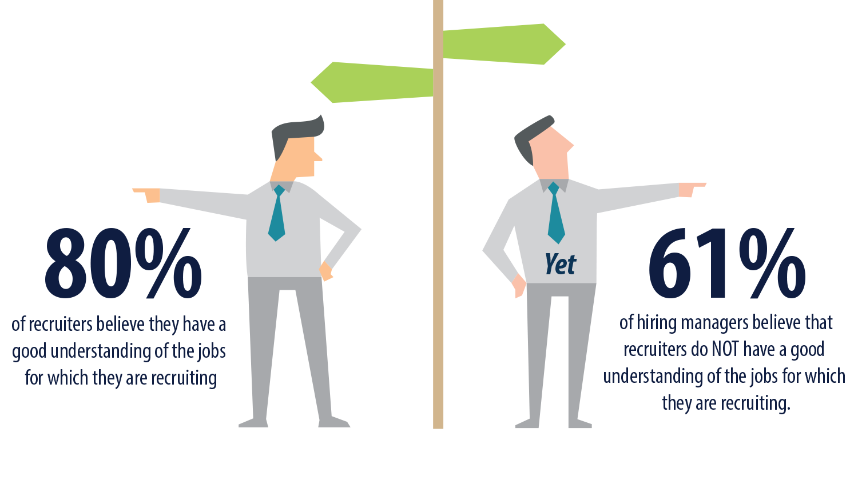
Where is the disconnect…

Slide 3
Recruiting: Who is the Expert?
Common View of Hiring Managers
Feel they are experts in recruiting
Uncertain of what they are looking for
Make hiring decisions based on factors inconsequential to the job
Fail to convey core necessities of position
Separate themselves from hiring process
Decisions often made on resume only

Slide 4
Recruiting: Who is the Expert?
Common View of Recruiters
Expense Center vs. Profit Center
Administrative/Transactional/Necessary Evil
Little to no sales training or aptitude
Perceived lack of industry/position knowledge
Not asking questions
Lack of consistent communication
Setting unrealistic expectations/no expectations
Allow the manager to lead

Slide 5
5
Keys to Leading the Hiring Manager
1
Proper Intake
2
Effective Communication
3
Applicant Analysis
4
Build Credibility
5
Metrics

Slide 6
Proper Intake

Slide 7
Beware the Job Description!
Serve as a crutch
Exclude top performing candidates
Can’t predict performance
“I’m looking for what it says here”
The perfect candidate syndrome
Recruiters stop asking questions
Hire for skill – fire for competencies
Proper Intake

Slide 8
Job Intake Question Checklist - Basics
Proper Intake
What is the Job title?
How many positions are we recruiting for?
What is the location of the role (s)?
What is the Reporting structure?
Manager vs Individual Contributor?
What is the team structure?
How long has the position been open?
Any difficulties facing the team?
Will they have budget or P/L responsibilities?
Will there be advancement opportunities?
The job description should include:
Company Background
Position Summary
Reporting Relationships
Major Responsibilities
Ideal Experience
Critical Competencies for Success
Short term Objectives

Slide 9
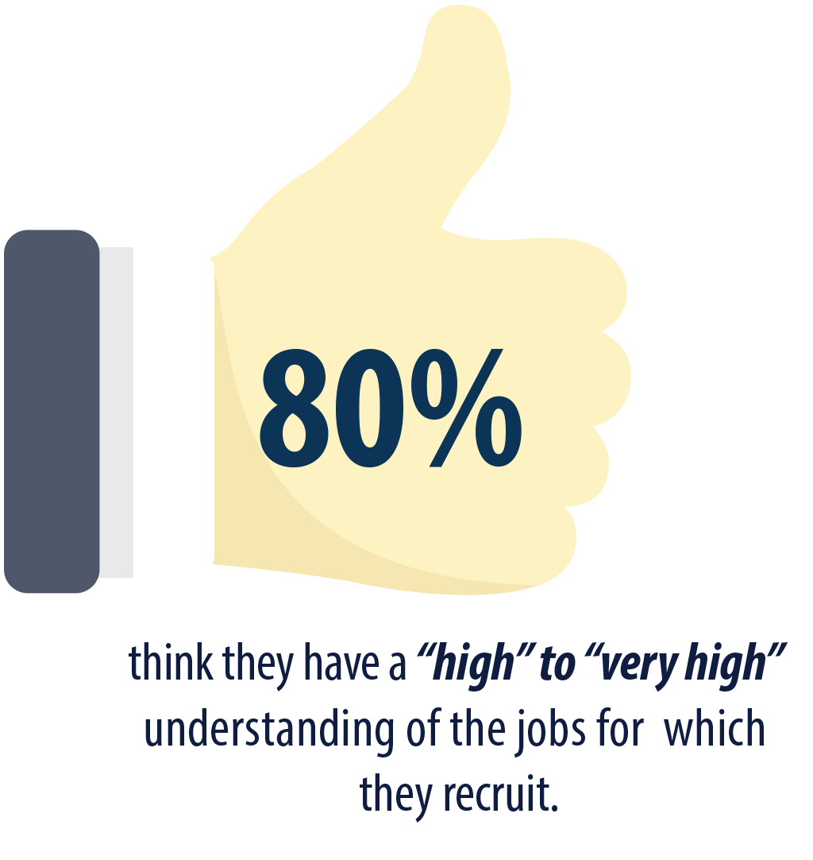
Job Intake Question Checklist
From the
Recruiter’s View..
Reason for the opening?
Must haves versus like to haves?
Years of experience?
Short term objectives?
Long term objectives?
Compensation?
Why the manager stays/joined?
Why candidate would work for manager?
Restate intake email - CYA

Slide 10
Effective Communication

Slide 11
Communicate Effectively
“My recruiter doesn’t understand my business”
“My recruiter doesn’t ask questions”
“My recruiter never responds”

Slide 12
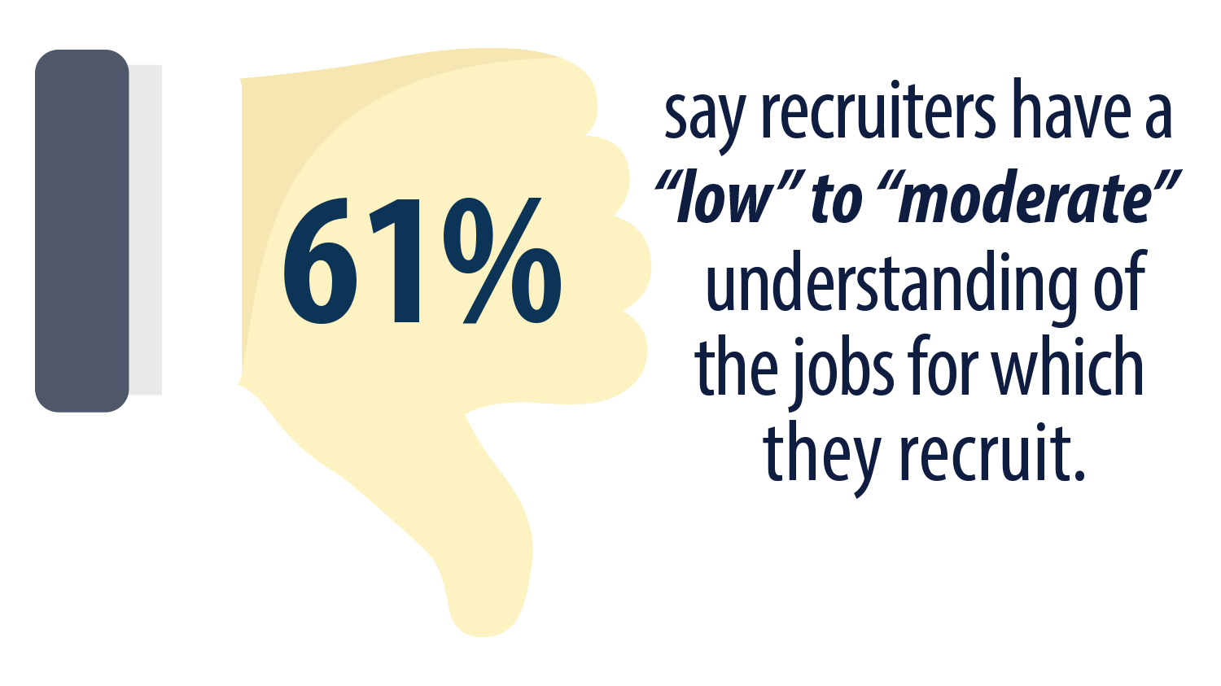
Communicate Effectively
Set Expectations
My manager doesn’t know what they need
My manager doesn’t return my calls
My manager prefers email
My manager wants to see all of the candidates

Slide 13
Communicate Effectively
Talk in their terms
Increased Revenue
Profitability
Efficiency
Cost of Open Position
Improved Customer Experience
Communicate Often, good AND bad
Don’t rely on email
Set expectations from the beginning

Slide 14
Applicant Analysis

Slide 15
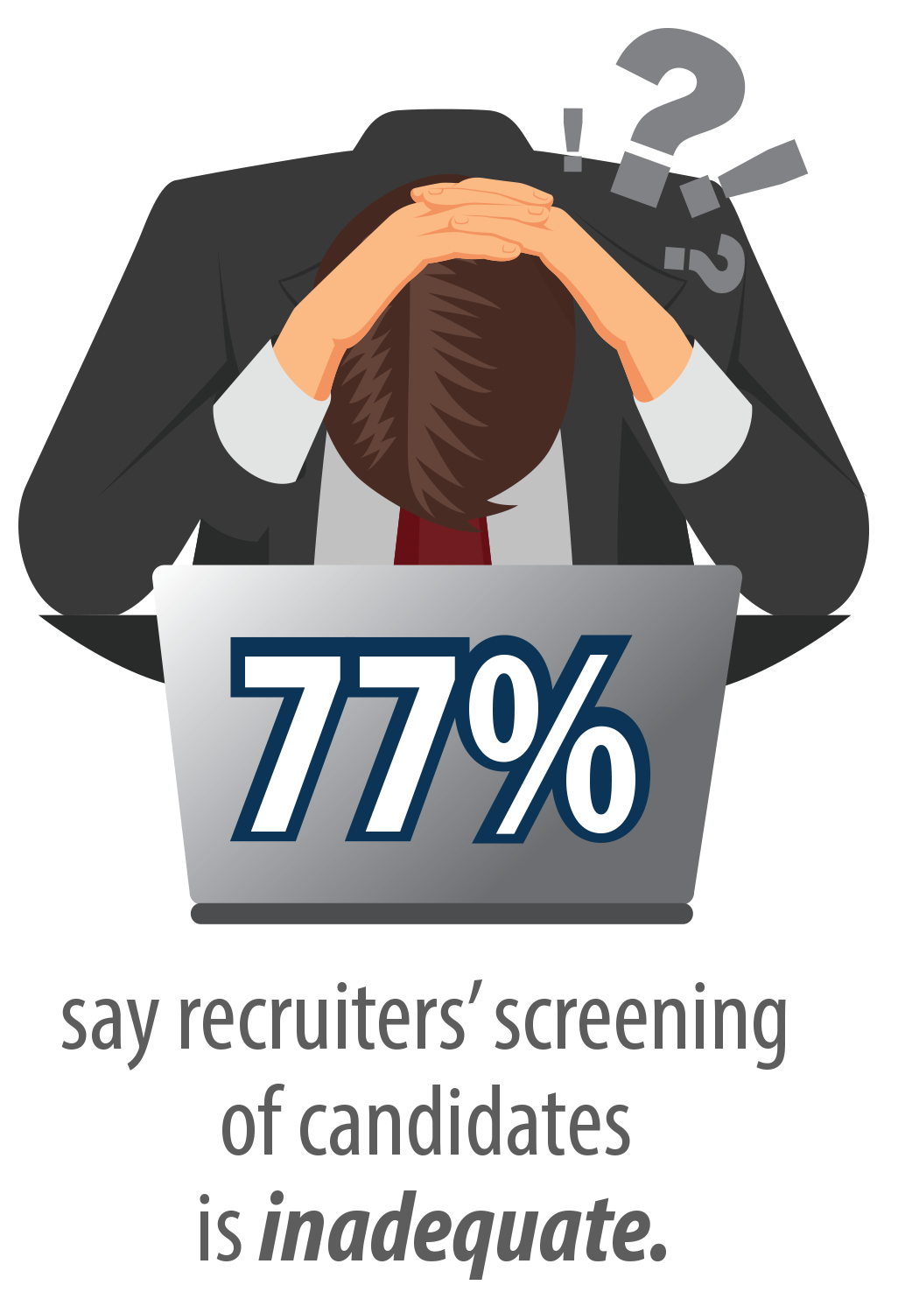
Applicant Analysis
It’s time to put a stop to Throw & Stick Recruiting
Take a look at these.....let me know your thoughts.
Which ones do you want to talk to?
Are you creating value?
Who is leading the process?
Quality versus quantity
Do you know your candidate?

Slide 16
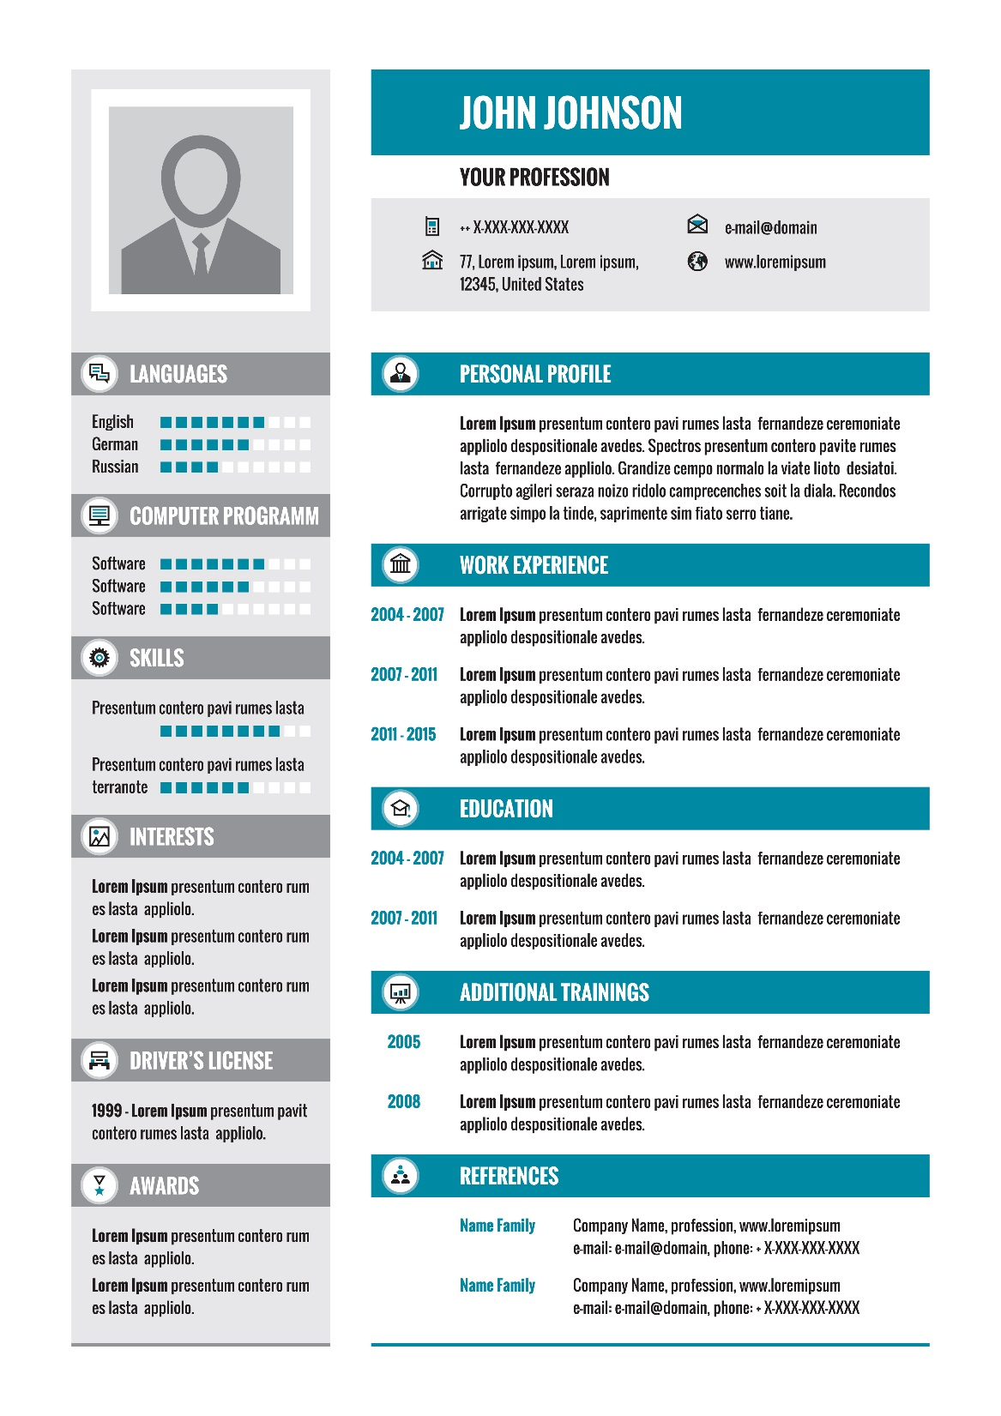
Applicant Analysis
Do you know your candidate?
Skills
What they have done
How they did it
Motivations
Points of pain
Points of pleasure
Notes:
Such qualities can be detected by communication with the candidate and building a professional relationship

Slide 17
Candidate DNA
Dimensions of Necessary Attributes
Skills/Experience
Attitude
Competency
Culture Fit
Notes:
Instead of collecting dozens of resumes and handing them over, it is the Recruiter’s job to be sure that each of those resumes represents a qualified potential candidate and be able to back up this belief with cited examples from conversations with the candidate

Slide 18
The 4 Dimensions Defined
Skills/Experience – Does the candidate have the training/education to do the job?
Attitude – Has the candidate shown they want to do the job?
Competency - Does the candidate have the ability/behaviors to do the job? (Rudy)
Culture Fit – Does the candidate do the job the way the company does or wants to?

Slide 19
Present on Target
Matching the Candidate to the Intake
Remember ‘must haves’ and ‘like-to-haves’
Focus on properly filling the need
Present identified motivators
Points of pain
Points of pleasure
Would you hire the candidate?

Slide 20
Build Credibility

Slide 21
Recruiting: Who is the Expert?
Common View of Recruiters
Expense Center vs. Profit Center
Administrative/Transactional/Necessary Evil
Little to no sales training or aptitude
Perceived lack of industry/position knowledge
Not asking questions
Lack of consistent communication
Setting unrealistic expectations/no expectations
Allow the manager to lead

Slide 22
Credibility & Trust
Sales 101
Build a Relationship
Qualify/Identify the Need
Overcome Objections
Fill the Need/Gain Agreement
Advance the Process

Slide 23
Credibility & Trust
Become Subject Matter Savvy
Google it
Google Alerts
Competitive Intelligence
Industry Intelligence
Industry Groups
Linkedin Groups
A day in the life

Slide 24
Credibility & Trust
If you’re the expert – lead like one!
Set expectations of the process
Set expectations for communication
Share high level sourcing/search strategy
Be realistic
No expectations lead to assumptions

Slide 25
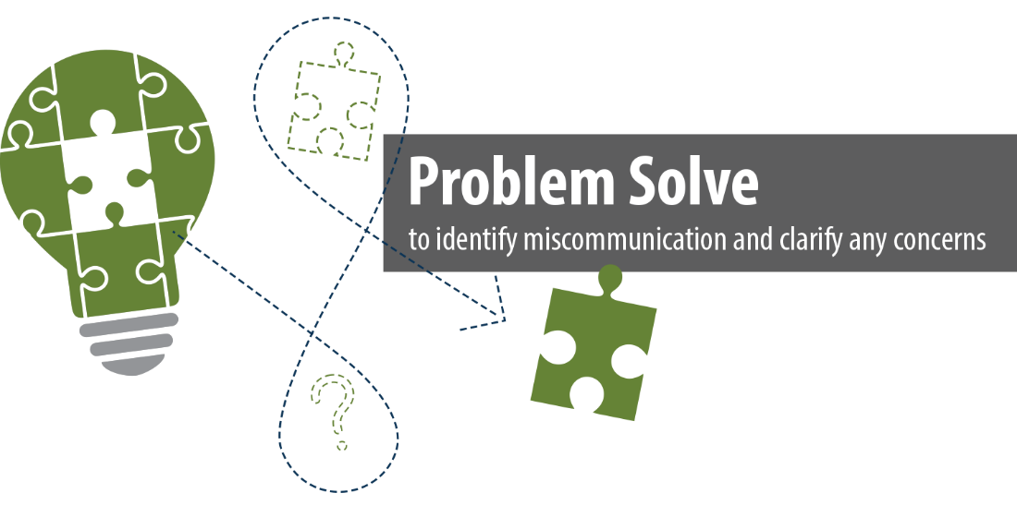

Slide 26
Metrics Utilization

Slide 27
What are recruiting metrics?
“Recruiting metrics are standards of measurement utilized by HR professionals and recruiters in order to gather, assess, and present information and analyses within the hiring process.”

Slide 28
Steve’s Definition
A Quantifiable Measurement that can be compared to established benchmarks
AND encourages behaviors focused on candidate quality, client experience and return on investment (ROI).

Slide 29
Use the Right Metrics
Recruiter of the Past: More HR and a lot more Transactional
Traditional Metrics
Time to Fill
Cost Per Hire

Slide 30
So, what Metrics truly matter?
Aberdeen Group Study

Slide 31
Use the Right Metrics
The Right Structure - Litmus Test
Examination
Correction
Transformation

Slide 32
We’ve created a Monster!
5 Keys to Repairing the Recruiter & Hiring Manager Relationship
Presented By:
Steve Lowisz

